Slide 1
Tanzania’s Department of Water & Agriculture has asked us to help them maximize scarce resources
The department head has asked us to help her prioritize which wells she should fix in the next year
She estimates the department can deploy, at most, five workers per day, who can each visit one site per day.

Slide 2
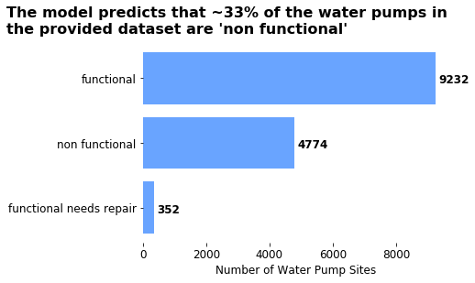
So we build a predictive model….
Which identifies almost 4x more water pumps than our client has capacity to service...
Note: The model’s overall accuracy rate is ~80%

Slide 3
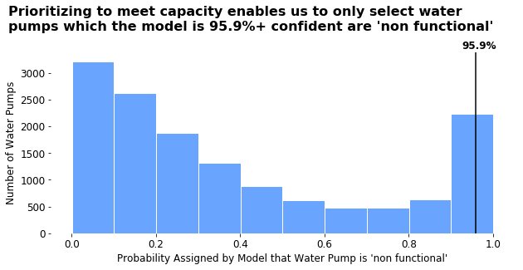
Luckily, Lambda taught us precision at k, which helps us to prioritize sites…
To really impressive our client, we even make a slick visualization to present our recommendation...
Note: The model’s overall accuracy rate is ~80%

Slide 4
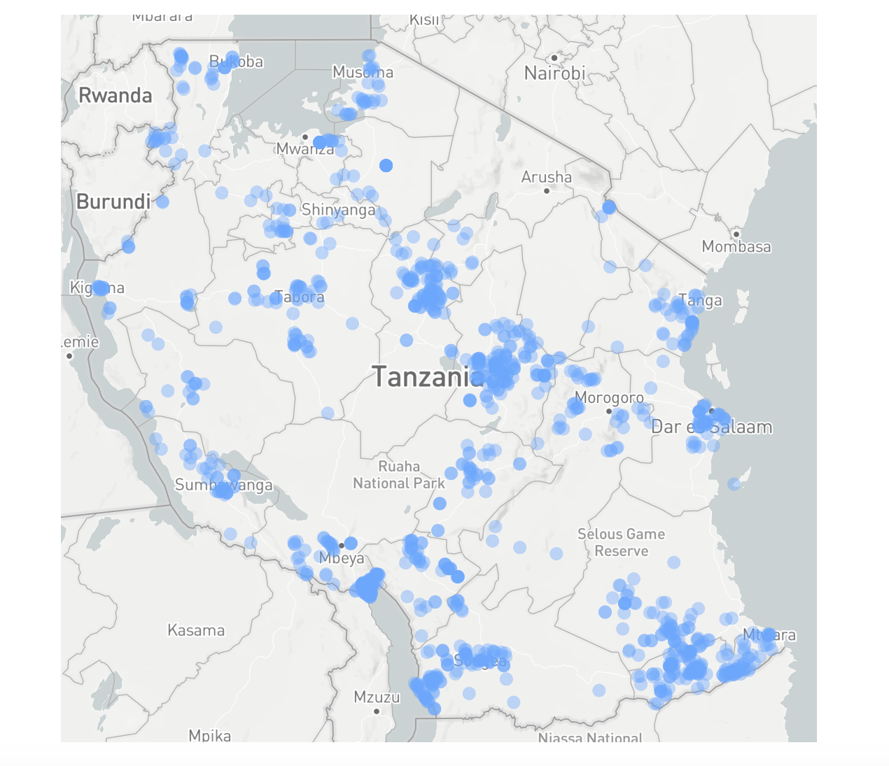
The prioritized pumps are spread throughout Tanzania
But I wouldn't want to be the maintenance team driving all over the country to visit these dispersed sites. Maybe there are other factors to take into account...

Slide 5
Which leads us to devise a way to prioritize pumps to be serviced by accounting for multiple factors…
Prioritizing based on impact changes our recommendations….
[2] The population for each site is scaled within the range 0,1 to be the same magnitude as the predicted probabilities. Missing population values imputed based on Regional and district mean population
[3] Distance is determined by creating 5 clusters, using a KMeans estimator, based on longitude and latitude. The five clusters each 'represent' one of the available workers the department has to service water pumps. Each site's latitude and longitude is then subtracted from those of the centroid to which that site belongs. The absolute value of the different between the site's coordinates and the centroid's are then averaged. Finally, the value is scaled within the range 0,1 to be the same magnitude as the predicted probabilities.

Slide 6
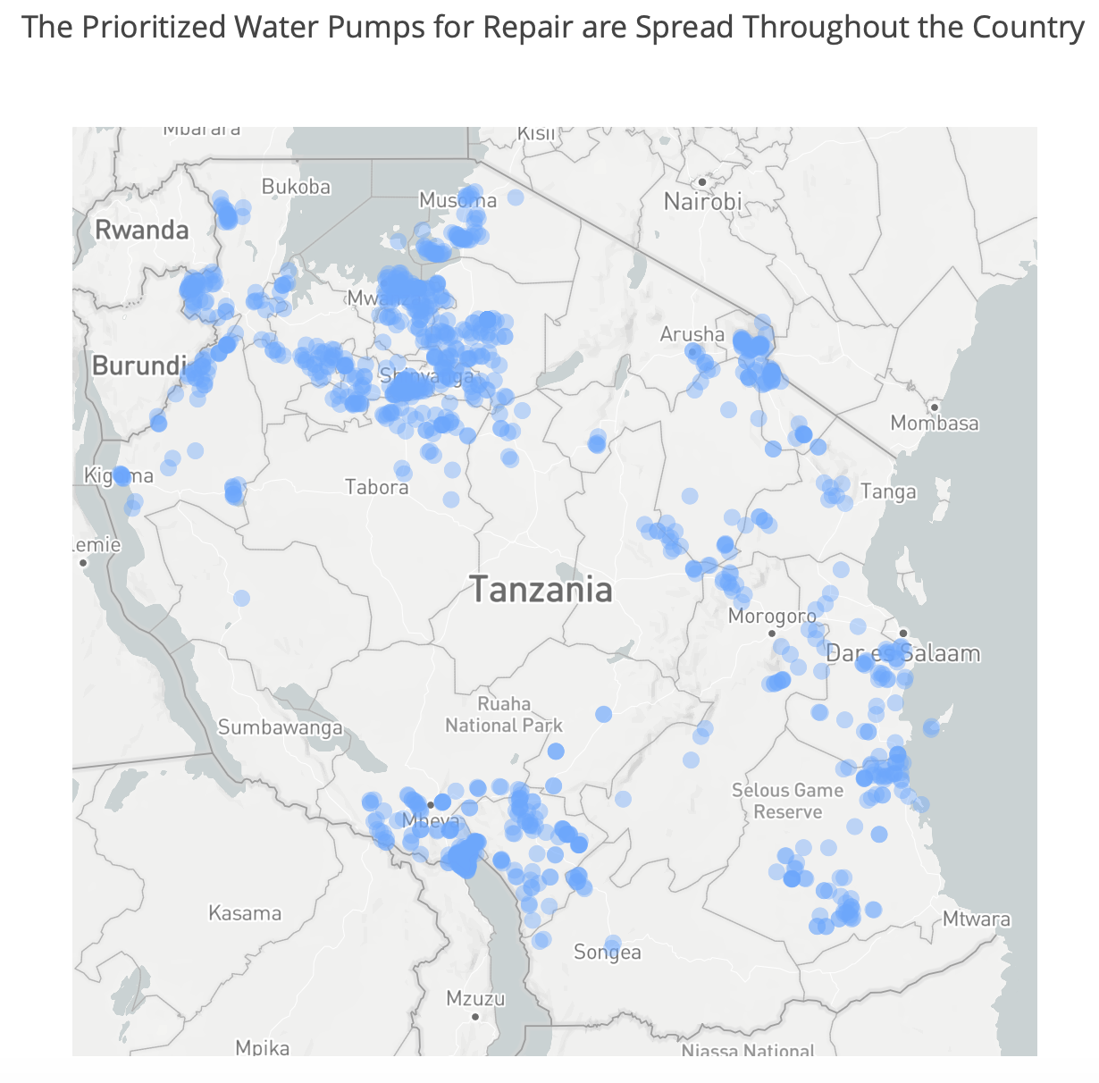
The prioritized pumps have shifted toward clusters in population dense areas
Servicing the prioritized water pumps over the next year will increase access to clean water for approximately 600,000 people

Slide 7
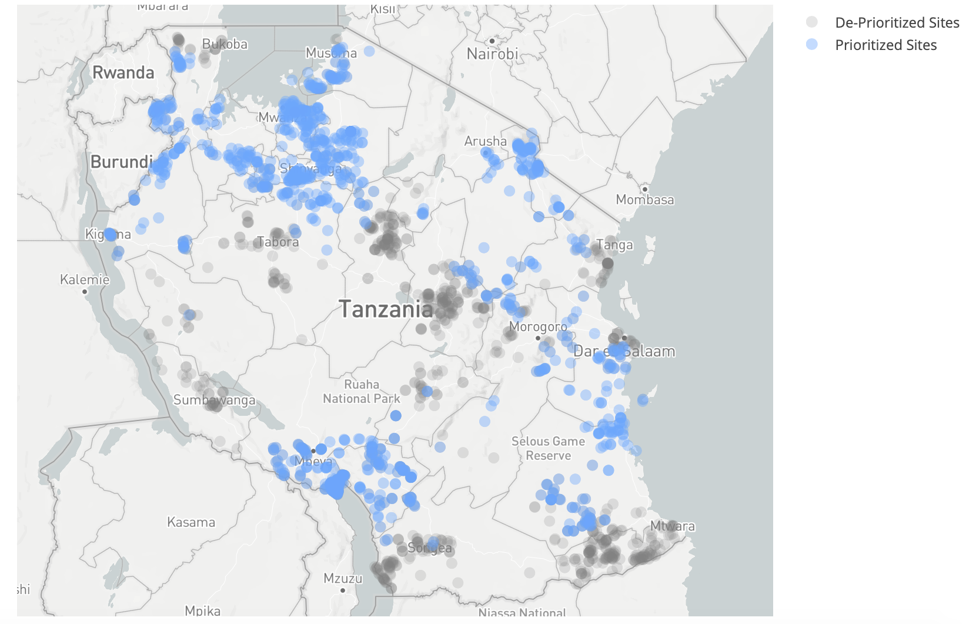
Did we create unintended consequences based on our definition of impact?

Slide 8
Appendix

Slide 9
Impact Score Formula
Probability pump is ‘non functional’
Relative distance from other pumps³
Impact Score
Population near well²

